Slide 1

DRIVER DROWSINESS DETECTION USING CNN
BY:
SHAINY SARIGALA 180030200
BOLLA LAHYA 180031128
BHUVANA PRIYA UPPALA 180031177
VATRAPU SRI LEKHA 180030193

Slide 2
INTRODUCTION:
Drowsiness detection system is a safety technology.
The eye movement of the driver is monitored live and whenever the driver feels asleep or closes eye for more than 2 sec. Then it alerts the driver with the help of the loud alarm. Thus preventing any accidents from happening.
Drowsy driving isn’t just falling asleep while driving. Drowsy driving can be as small as a brief state of unconsciousness when the driver is not paying full attention to the road.

Slide 3
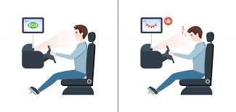
“DROWSINESS IS A BIGGEST PROBLEM FOR ROAD ACCIDENTS AND DATA SCIENCE IS THE BEST REMEDY FOR IT”

Slide 4
OBJECTIVE:
The main objective of this project is to prepare a prototype of a driver drowsiness system that alerts the driver when he is drowsy and sleepy.
This is achieved by the use of machine learning model to detect the face of the driver using a camera and analysing the state of the driver.

Slide 5
requirements:
Python
openCV - for face and eye detection.
Keras - To build our classification model
Tensorflow- Backend of the keras
Pygame - to play alarm sound

Slide 6
architecture:
The system is build with keras and CNN
CNN – it is special type of deep learning technique network which performs extremly well for image classification.
CNN basically consists of the input layer and the output layer and hidden layers which have multiple number of layers.

Slide 7
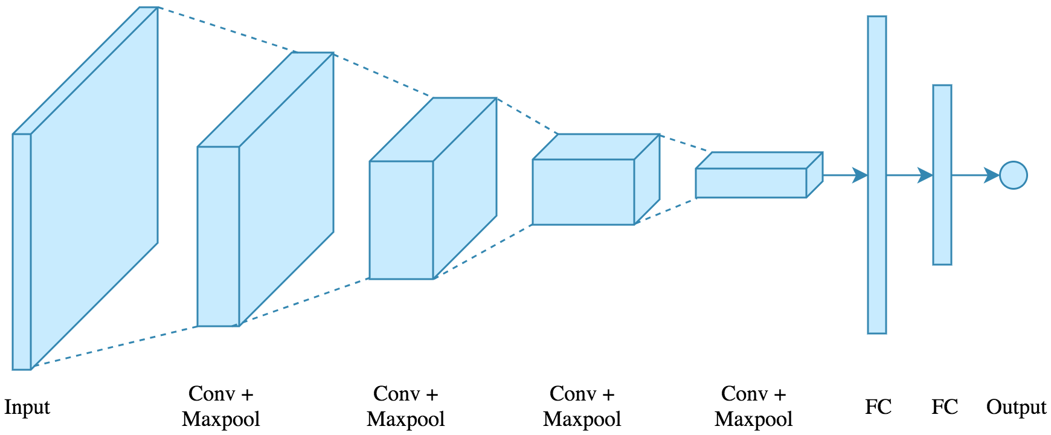

Slide 8
Working procedure:
STEPS:
STEP – 1 : Takes input as image from a camera with webcam.
We will take images as input.
To access webcam, we have to make make infinite loop that will capture each frame.
We will be using method in OpenCV i.e cv2.videocapture(0) to access the camera and set the capture object (cap).
Cap.read() will read each frame and we store the image in a frame variable.

Slide 9
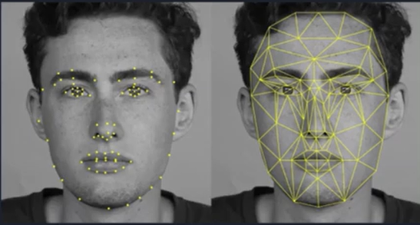
Working procedure:
STEP – 2 : Detect face in the image and create a Region of interest(ROI).
To detect the face in the image, we need to first convert the image into grayscale as he OpenCV algorithm for object detection takes gray images in the input.
We don’t need color information to detect the objects.We will be using haar cascade classifier to detect faces

Slide 10
Working procedure:
STEP – 3 : Detect the eyes from ROI and feed it to the classifier
The same procedure to detect faces is used to detect eyes. First, we set the cascade classifier for eyes in leye and reye respectively then detect the eyes.
Now we need to extract only the eyes data from the full image.
This can be achieved by extracting the boundary box of the eye and then we can pull out the eye image from the frame with this code.
l_eye only contains the image data of the eye. This will be fed into our CNN classifier which will predict if eyes are open or closed. Similarly, we will be extracting the right eye into r_eye.

Slide 11
Working procedure:
STEP – 4 : Classifier will Categorize whether Eyes are Open or Closed
We are using CNN classifier for predicting the eye status. To feed our image into the model.
First, we convert the color image into grayscale using r_eye= cv2.cvtColor(r_eye, cv2.COLOR_BGR2GRAY).
Then, we resize the image to 24*24 pixels as our model was trained on 24*24 pixel images cv2.resize(r_eye, (24,24)). We normalize our data for better convergence r_eye=r_eye/255.
Now we predict each eye with our model Ipred = model.predict_classes(l_eye).
If the value of Ipred[0] = 1, it states that eyes are open, if value of Ipred[0] = O then, it states that eyes are closed.

Slide 12
Working procedure:
STEP – 5 : Calculate Score to check whether Person is Drowsy.
The score is basically a value we will use to determine how long the person has closed his eyes.
So if both eyes are closed, we will keep on increasing score and when eyes are open, we decrease the score.
We are drawing the result on the screen using cv2.putText() function which will display real time status of the person.
A threshold is defined for example if score becomes greater than 15 that means the person's eyes are closed for a long period of time. This is why we beep the alarm using sound.play().

Slide 13

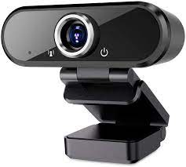
Real world application:
This system can be used in any automobile with ease.
This can be done by using Raspberry Pi and with the help of a Web Camera and an alarm for the alarm sound.
The Driver eyes are constantly monitored by WebCam.
This Data is sent to the image classifier model which is running on Raspberry Pi.

Slide 14

Real world application:
The classifier checks every frame and classifies the frame as open or close.
If the eyes are being closed for a few seconds straight then the Alarm is Triggered.
The alarm goes off only when the driver is active and his eyes are open without any drowsiness.

Slide 15
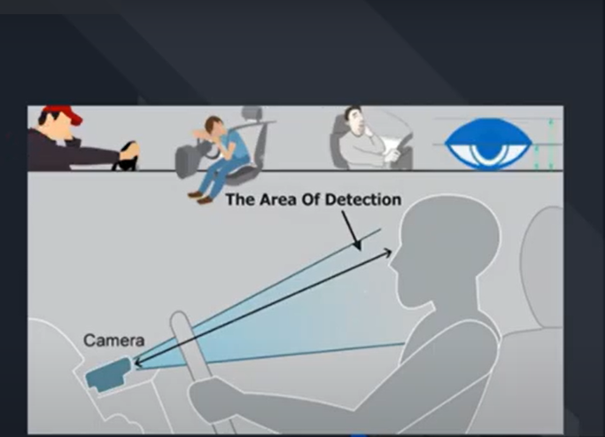
Conclusion:
This system can be used to reduce the amount of road accidents that happens to great extent.
This can save a lot of lives, which is a main motive of this system.
This system does not need any complex system to work effectively.
Taking the facts into consideration driver drowsiness detection system is the future of road safety.

